Slide 1


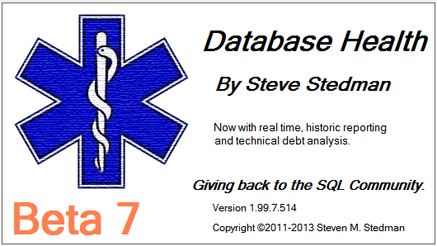
Advanced Common Table Expressions
Presented by Steve Stedman

Slide 2
About the Speaker/Author (Steve Stedman)
Working at Emergency Reporting as CTO
Joes2Pros
Author of the Common Table Expression Book
Instructor at the Joes2Pros Academy
23 Years of database work (Microsoft 1990-1991)
Developer of the Database Health Application
http://DatabaseHealth.com
Volunteer Firefighter and EMT
Twitter: @SqlEmt
Website: http://SteveStedman.com

Slide 3
Downloadable Content
This presentation and all samples are available at:
http://SteveStedman.com

Slide 4
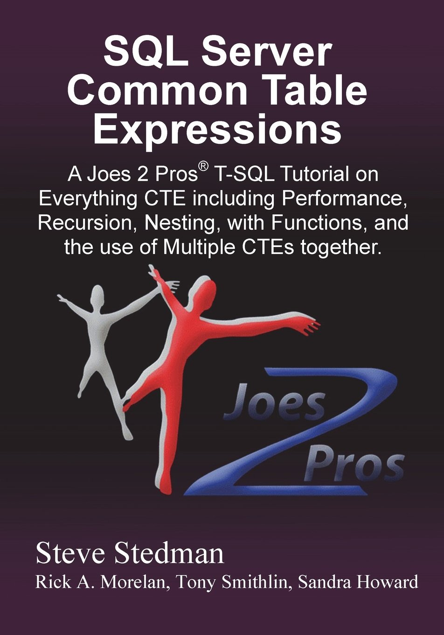
Common Table Expressions Book
Published May 2013
Available at Amazon.com and at Joes2Pros.com
Print and Kindle versions both available.
Today’s topic comes from Chapter 5, 8, 10 and 11
of
SQL Server Common Table Expression

Slide 5
Audience Survey
How many people have heard of CTEs?
How many people have used CTEs?
How many people have used recursive CTEs?
How many people have deleted data with a CTE?
How many people use CTEs every day?
How many people have used recursive CTEs with multiple anchor queries?
How many people are planning on taking the 70-461 Microsoft Exam

Slide 6
CTE – Benefits coming your way!
Hierarchical Recursive CTEs
Manipulating Data
Common Use Cases
CTE Performance Considerations

Slide 7
Recursion made to look good. Hierarchical CTEs
Chapter 5

Slide 8
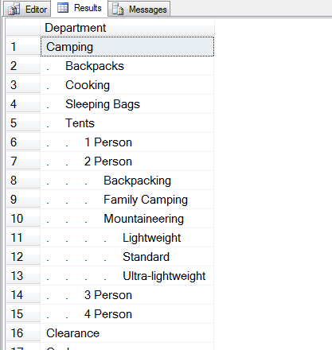
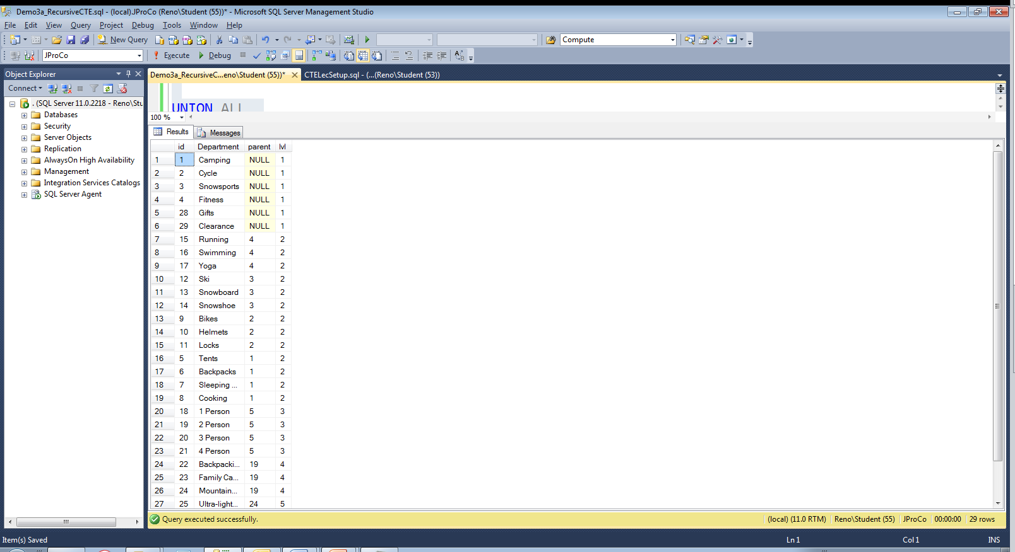
Chapter 5 – Recursion made to look good – Hierarchical CTEs.

Slide 9
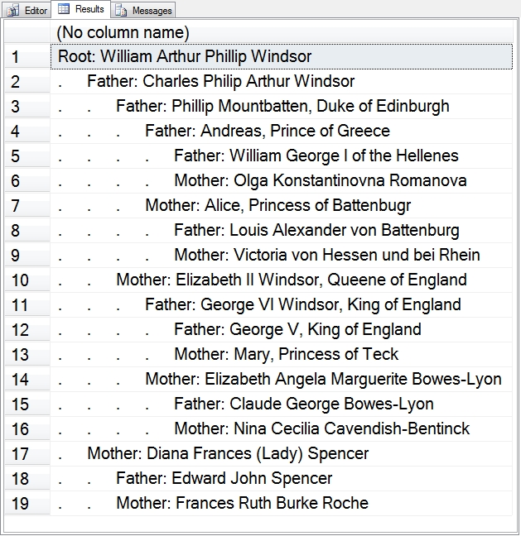
Hierarchy in Multiple Recursive Queries possible.

Slide 10
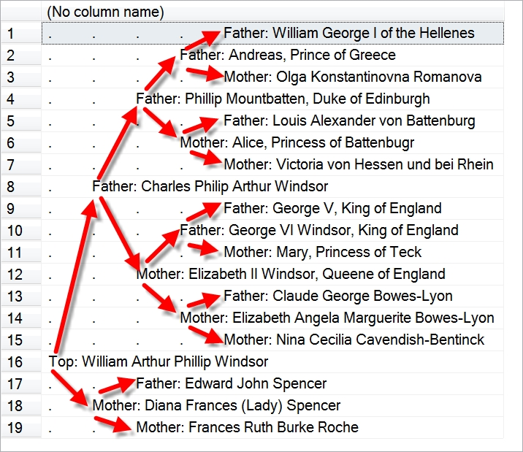
Hierarchy with advanced formatting.

Slide 11
Chapter 5
Demo

Slide 12
Manipulating Data: Insert Update Delete
Chapter 8

Slide 13
Chapter 8 – DELETE
DELETE FROM CTE;
Are the following SQL Statements valid?
Can you delete from a CTE?
What does that mean?
;WITH CustomerCTE AS
(
SELECT *
FROM Customer
WHERE LastName like 'Williams'
)
DELETE FROM CustomerCTE;
;WITH CustomerCTE AS
(
SELECT c.*
FROM Customer AS c
INNER JOIN SalesInvoice AS si
ON si.CustomerID = c.CustomerID
WHERE c.LastName like 'Williams'
)
DELETE FROM CustomerCTE;

Slide 14
Chapter 8 – DELETE FROM CTE;
Demo

Slide 15
Chapter 8 – INSERT
INSERT INTO CTE;
Are the following SQL Statements valid?
Can you INSERT INTO a CTE?
What does that mean?
;WITH CustomerCTE AS
(
SELECT *
FROM Customer
WHERE LastName like 'Stedman'
)
INSERT INTO CustomerCTE
(CustomerID,FirstName,LastName)
VALUES (99999, 'Steve', 'Stedman');
;WITH CustomerCTE AS
(
SELECT c.*
FROM Customer AS c
INNER JOIN SalesInvoice AS si
ON si.CustomerID = c.CustomerID
WHERE c.LastName like 'Stedman'
)
INSERT INTO CustomerCTE
(CustomerID, FirstName, LastName)
VALUES (99999, 'Steve', 'Stedman');

Slide 16
Chapter 8 – INSERT INTO CTE;
Demo

Slide 17
Chapter 8 – UPDATE
UPDATE CTE;
Are the following SQL Statements valid?
Can you UPDATE a CTE?
What does that mean?
;WITH CustomerCTE AS
(
SELECT c.*
FROM Customer AS c
WHERE c.LastName like 'Williams'
)
UPDATE CustomerCTE
SET LastName = 'Willie';
;WITH CustomerCTE AS
(
SELECT c.*, si.Comment
FROM Customer AS c
INNER JOIN SalesInvoice AS si
ON si.CustomerID = c.CustomerID
WHERE c.LastName like 'Williams'
)
UPDATE CustomerCTE
SET Comment = 'Some Comment',
CompanyName = 'Willies Toys';

Slide 18
Chapter 8 – UPDATE CTE;
Demo

Slide 19
INSERT, UPDATE, DELETE Notes
Insert, Update, and Delete all work against a CTE with only a single base table.
Delete does not work for any CTE with multiple base tables referenced in the CTE query.
Insert and Update works against a CTE with multiple base tables as long as only one base table is being udpated.

Slide 20
Common Use Cases: Alternative to a Numbers table Finding Holes Scrubbing duplicates
Chapter 10

Slide 21
Alternative to a Numbers Table.
Demo
;WITH Numbers (N) AS
(
SELECT 1
UNION ALL
SELECT 1 + N FROM Numbers
WHERE N < 1000
)
SELECT *
FROM Numbers
OPTION (MAXRECURSION 1000);

Slide 22
Finding Holes.
Demo
;WITH Numbers (N) AS
( SELECT 0
UNION ALL
SELECT 1 + N FROM Numbers
WHERE N < 23)
, OrderHours (HourOfDay, TheCount) AS
( SELECT DATEPART(HOUR, OrderDate) as HourOfDay,
COUNT(1) AS TheCount
FROM SalesInvoice
WHERE OrderDate < '02/01/2006'
GROUP BY DATEPART(HOUR, OrderDate) )
SELECT n.N AS HourOfDay, ISNULL(oh.TheCount, 0) OrderCount
FROM OrderHours oh
RIGHT JOIN Numbers n ON n.N = oh.HourOfDay
ORDER BY TheCount ASC;

Slide 23
Scrubbing duplicates.
Demo
WITH CustomerCTE AS
(
SELECT *, ROW_NUMBER() OVER(PARTITION BY LastName,
FirstName ORDER BY CustomerID) AS DupNum
FROM Customer
)
DELETE
FROM CustomerCTE
WHERE DupNum > 1;

Slide 24
The need for speed Understanding CTE performance
Chapter 11

Slide 25
11. CTE Performance
Non-Recursive Performance
Multiple references to a single CTE
CTEs vs. Derived Tables
CTEs vs. Views
Multiple CTEs in a query
Recursive Performance
Deep Recursion

Slide 26
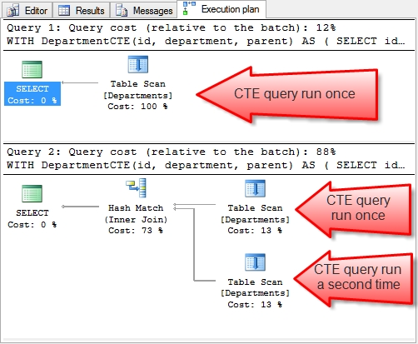
Multiple references to a single CTE

Slide 27
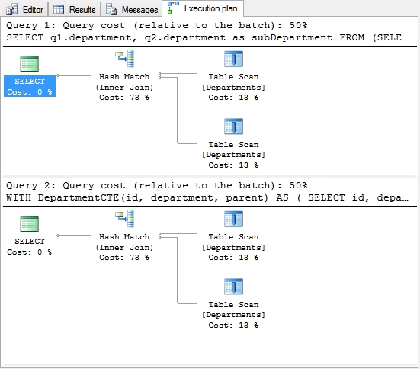
CTEs vs. Derived Tables

Slide 28
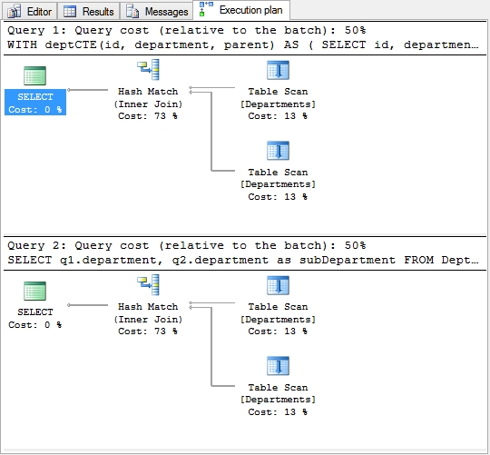
CTEs vs. Views

Slide 29
Multiple CTEs in a query

Slide 30
Nested CTEs
Take it to the extreme
with cte0 as ( select 1 as num ) , cte1 AS (SELECT * FROM cte0) , cte2 AS (SELECT * FROM cte1)
Repeated from 2 to 254.
, cte255 AS (SELECT * FROM cte254) , cte256 AS (SELECT * FROM cte255) , cte257 AS (SELECT * FROM cte256) select * from cte257;

Slide 31
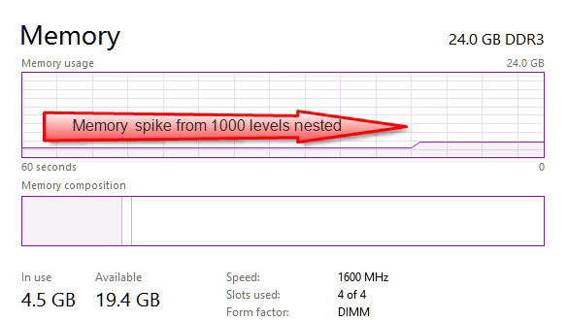
Nested CTEs

Slide 32
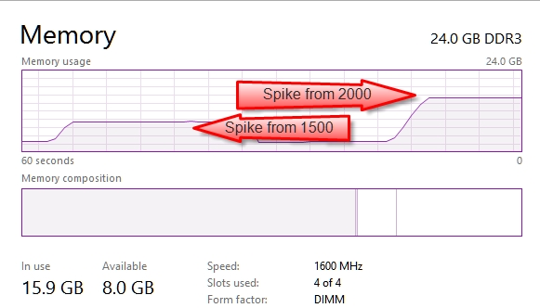
Nested CTEs

Slide 33
Nested CTEs

Slide 34
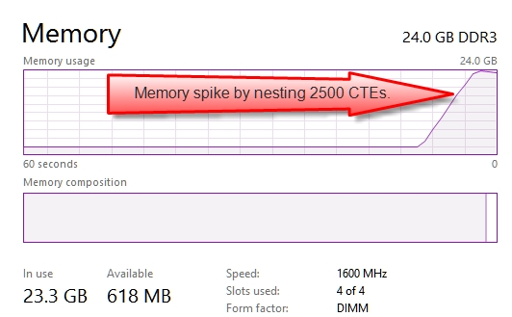
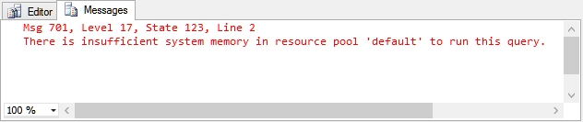
Nested CTEs

Slide 35
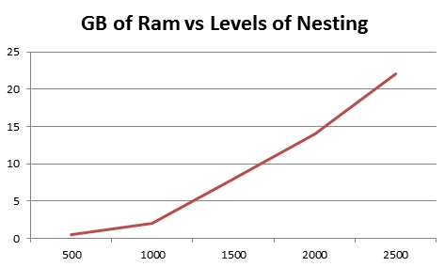
Recursive Performance

Slide 36
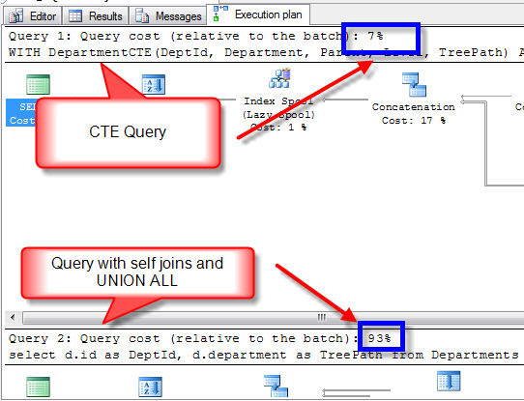
Recursive Performance

Slide 37
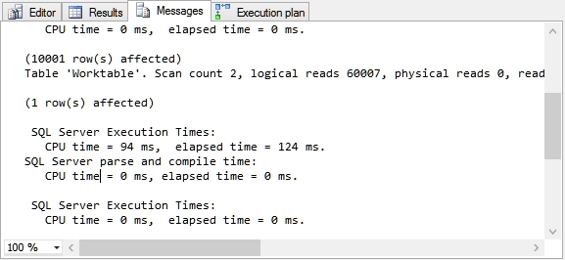
Deep Recursion

Slide 38
Chapter 11
Demo

Slide 39
More Information
Follow me on Twitter
@SqlEmt
Database Health Project
http://DatabaseHealth.com
Visit my website
http://stevestedman.com
Send me an email:
Steve@SteveStedman.com
Download Slides and Sample TSQL
http://stevestedman.com/speaking/

Slide 40
Common Table Expressions Book
Published May 2013
Available at Amazon.com and at Joes2Pros.com
Print and Kindle versions both available.

Slide 43
CTE – Fact or Fiction
Steve Stedman
Debunking common myths about
Common Table Expressions

Slide 44
1. CTE Executions
As a named result set, the CTE is only run once even if it is referenced multiple times in a query.
True or False?
FALSE The CTE is executed once for EACH time that it is referenced in a query.

Slide 45
1. CTE Executions Explained
;WITH deptCTE(id, department, parent) AS
(SELECT id, department, parent
FROM Departments)
SELECT q1.department, q2.department
FROM deptCTE q1
INNER JOIN deptCTE q2 on q1.id = q2.parent
WHERE q1.parent is null;
In this example the deptCTE is executed twice

Slide 46
2. CTEs are proprietary
CTEs are proprietary to Microsoft SQL Server.
True or False?
FALSE Common Table Expressions are supported by several major database platforms, among them PostgreSQL, DB2, Oracle and SQL Server, defined in SQL-99 spec

Slide 47
3. CTE and Hierarchical Queries
CTEs are a great way to create recursive hierarchical queries.
True or False?
TRUE Recursive hierarchical queries are easy to write with a CTE. CTE’s save time, are easy to follow, and work great for hierarchical data.

Slide 48
5. Database Versions
SQL Server only supports CTE’s on SQL Server Enterprise Edition 2008R2 and newer.
True or False?
FALSE Common Table Expressions have been supported since SQL Server 2005 and are available in all versions.

Slide 49
6. Stored Procedures and Functions
CTEs can be defined in user-defined routines, such as functions, stored procedures, triggers, or views.
True or False?
TRUE Common Table Expressions can be defined and used inside of stored procedures and functions.

Slide 50
7. CTEs and Nesting
CTEs can be nested and one CTE can reference an earlier CTE.
True or False?
TRUE Common Table Expressions can be nested. Just define multiple CTE’s and reference an earlier CTE from a later one.

Slide 51
8. Indexing CTEs
Indexes can be added to CTEs to boost performance.
True or False?
FALSE A Common Table Expression is a temporary, "inline" view - you cannot add an index to a CTE.

Slide 52
9. VIEW vs CTE
Which performs better, a non-recursive CTE or a VIEW?
They are the same.
The big gain is the recursive CTE, which you can’t achieve with a view.

Slide 53
10. CTE’s and Data Paging
CTE’s are a great way to do Data Paging for a result grid.
True or False
It Depends…...
SQL Server 2012 has the new OFFSET and FETCH clause on select statements, which is easier than CTE’s. For 2005, 2008 and 2008R2 the CTE is the best option.

Slide 54
11. CTE’s performance
Recursive CTE’s perform the same as other pseudo recursive solutions?
True or False
FALSE…...

Slide 55
12. CTE’s and TempDB
CTE’s are similar to Temp Tables or Table Variables in their use of TempDB?
True or False
FALSE Temp Tables and Table Variables both use TempDB, CTE’s do not…...
See my blog posting for all the details on this one.
http://stevestedman.com/?p=2053
It is more than we have time to prove today.

Slide 56
13. Data Paging
An alternative to a CTE would be to use the ROW_NUMBER function in the WHERE clause to filter the results.
True or False?
FALSE ROW_NUMBER can be used to get the current row number in the result set, but it is a windowing function, and windowing functions are not allowed to be used in the WHERE clause.

Slide 57
More Information
Follow me on Twitter
@SqlEmt
Database Health Project
http://DatabaseHealth.com
Visit my website
http://stevestedman.com
Send me an email:
Steve@SteveStedman.com
Download Slides and Sample TSQL
http://stevestedman.com/speaking/

Slide 58
Common Table Expressions Book
Published May 2013
Available at Amazon.com and at Joes2Pros.com
Print and Kindle versions both available.

